Slide 1

DATABASE MANAGEMENT TECHNOLOGIES
MDS271
ANGELINE A
2348409

Slide 2


Diabetes Prediction!
In this project, we are going to work with Diabetes data, which helps in the prediction of Diabetes…

Slide 3

Table of contents
1
3
2
4
Creation of tables
Connection & Importing
The tables are in MySQL Workbench
Importing the csv file into MongoDB
Exporting
Analyzation
Exporting MySQL in csv format
Analyzing the data and performing operations in mongosh

Slide 4
CREATION OF TABLE
We first create the database named mongodb and with the use of that database, we create a table named Diabetes Prediction…. We created Five tables named Patients, LabResults, MedicalHistory, Vitals, DiabetesPrediction…

Slide 5
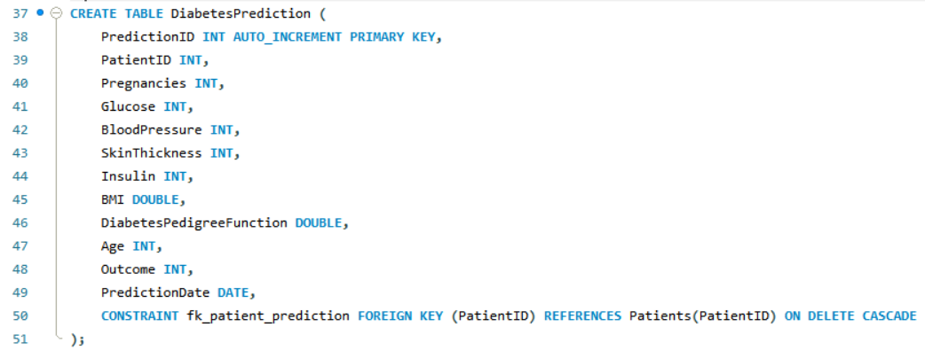
The needed data are inserted as the column

Slide 6
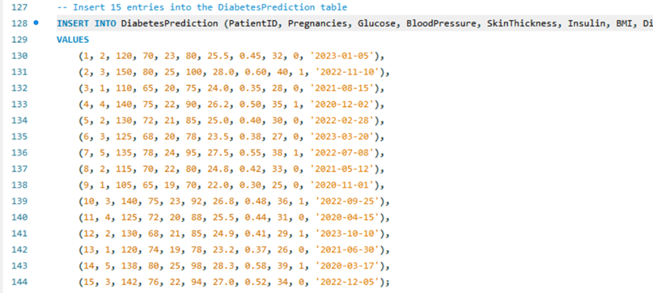

Insertion of Data

Slide 7
Exporting

Slide 8

Exporting Data
To export the data (table),
Right click table
Table Data Export Wizard
Give the location
Finish

Slide 9
CONNECTION
& IMPORTING

Slide 10



CONNECTION
The localhost is connected and the connection is made
Database is created with a name CAT2

Slide 11



IMPORTING
Import data
Select the file

Slide 12
ANALYZATION

Slide 13
Mongosh
Mongosh is opened and the database CAT2 is used there and certain operations are performed

Slide 14
OPERATIONS PERFORMED
Find
Insert
Values are found based on some of the constraints
Values are inserted (One or Many)
Delete
Update
Read
Values are deleted
Updation of values upon conditions
Retrieving the data

Slide 15

DELETE

Slide 16
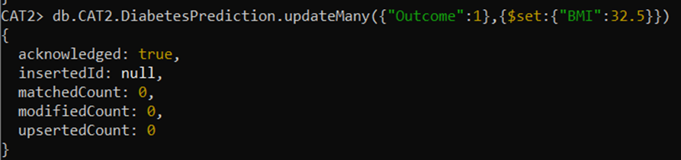
UPDATE

Slide 17
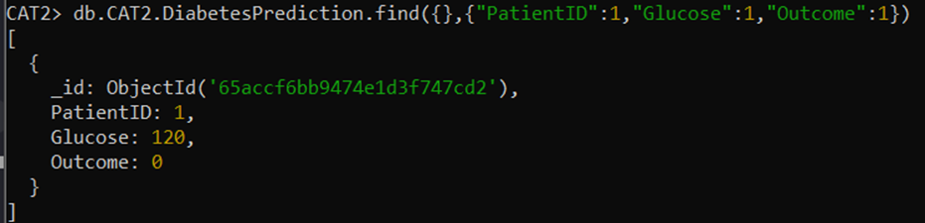
RETRIEVE

Slide 18
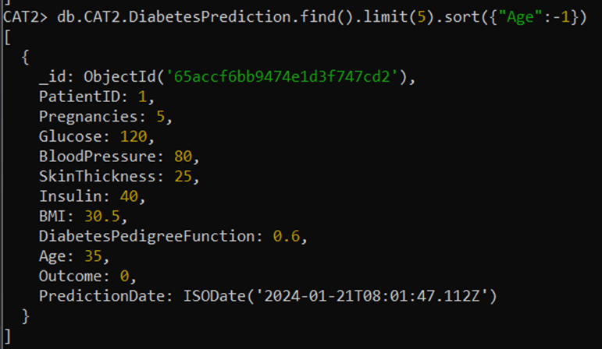
LIMIT & SORT

Slide 19
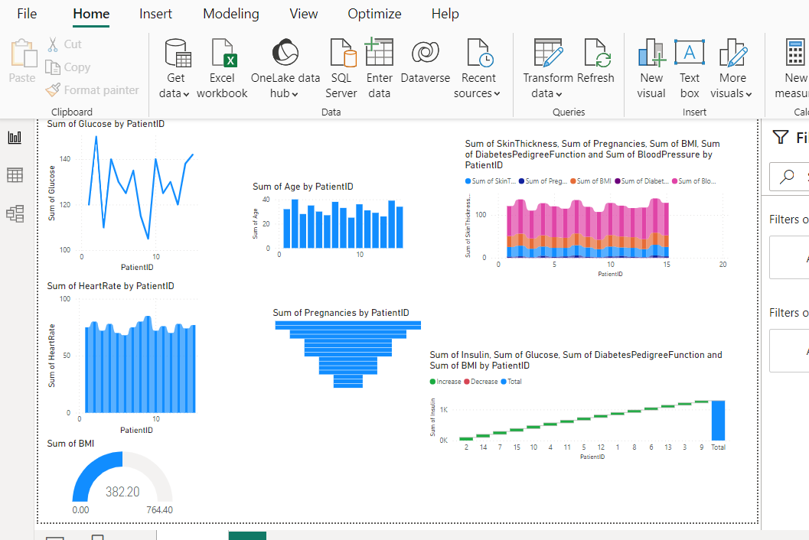
POWERBI

Slide 20
CONCLUSION
The mongodb connection is made successfully and the data has been analyzed properly

